Slide 1

GOKARAJU RANGARAJU
Institute of Engineering and Technology
Department of Information Technology
RTRP Review-2
2 MAY 2025
SMART AMBULANCE TRAFFIC CONTROL SYSTEM USING BLUETOOTH.
Team No : C07
B.Mahesh Chandra 23241A12D7
R.Shasheel 23241A12J1
P.Rajesh 23241A12H8
Under the Guidance of
Dr. V Akila
Designation
Department of IT

Slide 2
OUTLINE
Abstract
Introduction
Code Implementation
Results
Conclusion(brief about what you want to develop/implement

Slide 3
Abstract
Traffic congestion in urban areas often causes significant delays for emergency vehicles, leading to critical situations for patients in need of urgent medical care. This project presents a Smart Ambulance Traffic Control System using Bluetooth to provide ambulances with priority passage at traffic signals. The system consists of HC-05 Bluetooth modules installed in ambulances and Bluetooth receivers at traffic junctions. When an ambulance approaches a signal, the receiver detects its presence and transmits data to a microcontroller, which automatically switches the traffic light to green in the ambulance’s direction while turning others red, ensuring a clear path.To enhance monitoring and control, a web-based dashboard displays real-time traffic updates and ambulance detections.

Slide 4
Introduction
In today’s fast-growing cities, traffic congestion poses a major challenge for emergency services, especially ambulances. Delays in reaching hospitals can lead to life-threatening situations for patients. To overcome this issue, Smart Ambulance Traffic Control Using Bluetooth is an innovative solution designed to provide automatic priority to ambulances at traffic signals.
This system uses Bluetooth technology (HC-05 module) to detect ambulances approaching a traffic junction. The Bluetooth receiver installed at the signal identifies the ambulance and automatically switches the traffic light to green, allowing the ambulance to pass without delay. The system works without human intervention, making it faster, reliable, and efficient.

Slide 5
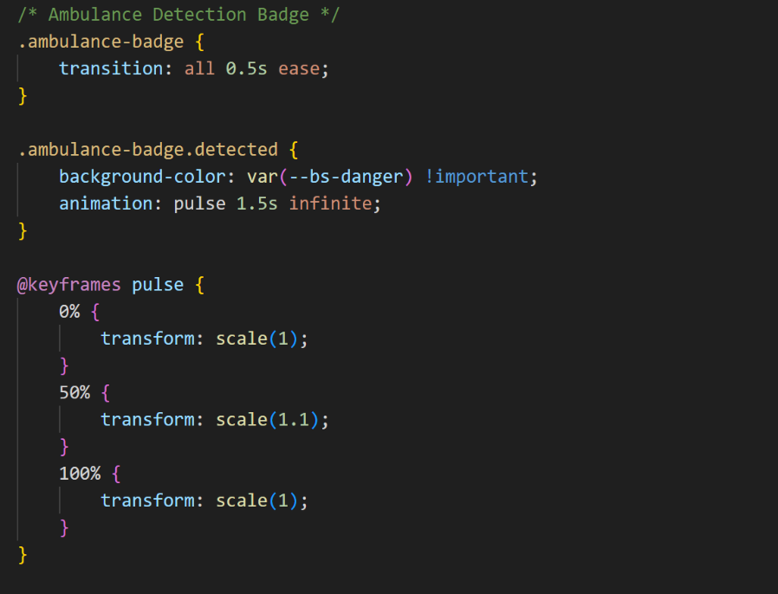
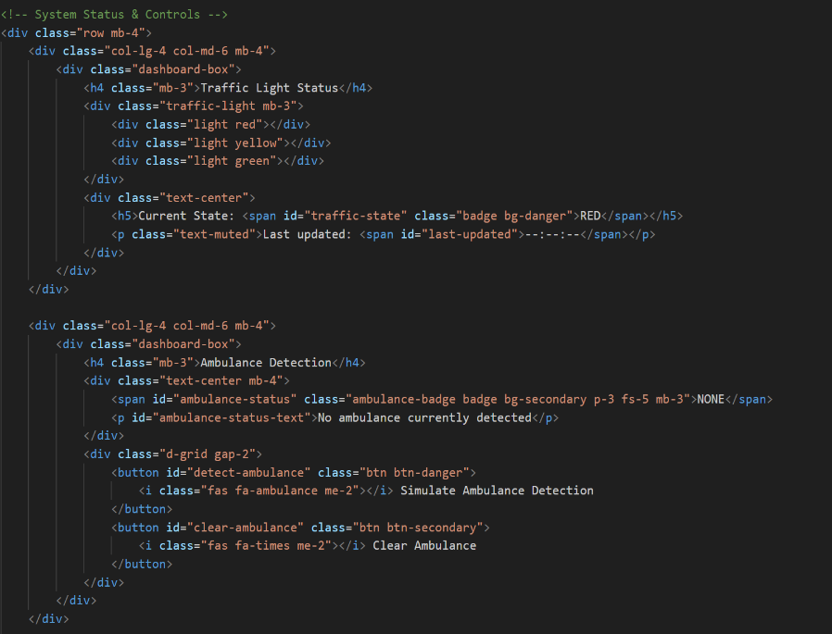

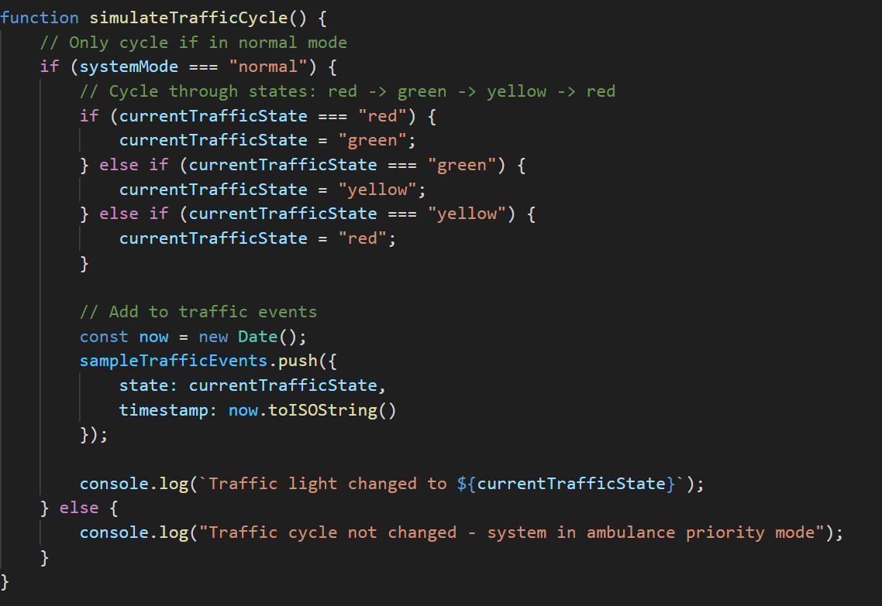
Code Implementation

Slide 6
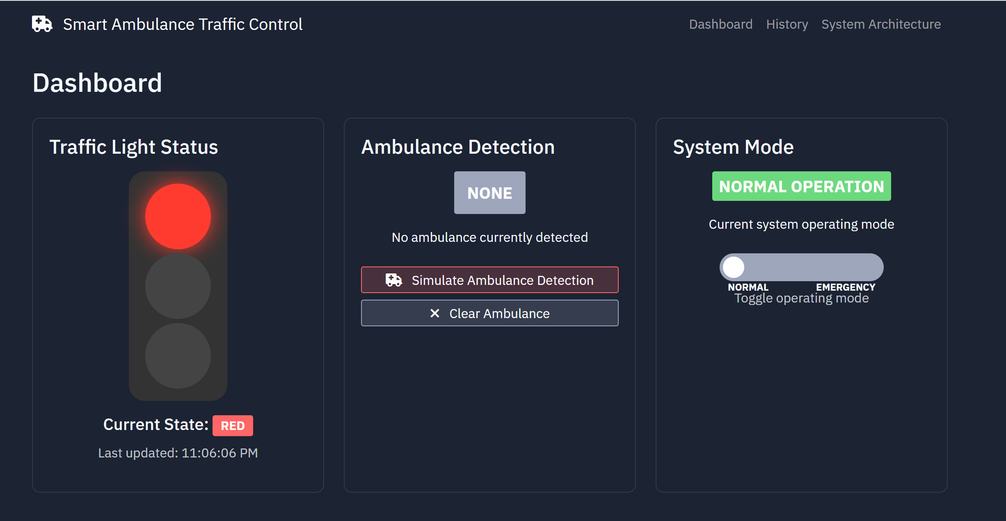
Results

Slide 7


Slide 8
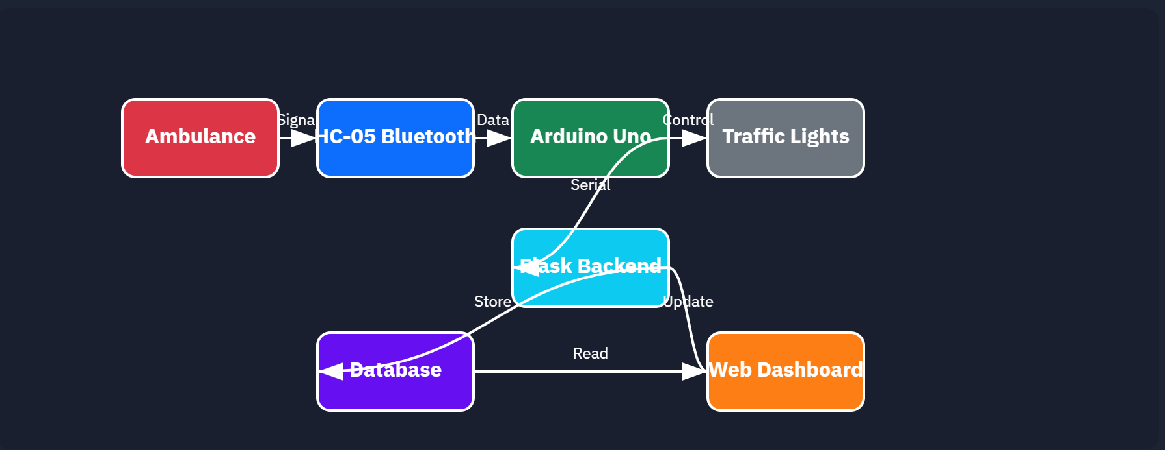
Architecture

Slide 9
Conclusion
The Smart Ambulance Traffic Control System using Bluetooth provides an efficient and cost-effective solution to prioritize ambulances at traffic signals and reduce emergency response time. By using HC-05 Bluetooth modules with Arduino, the system automatically detects approaching ambulances and switches traffic lights to green without manual intervention.
This project helps in overcoming the challenges of traffic congestion and ensures faster movement of emergency vehicles, ultimately saving lives. The integration of a web-based monitoring system enhances the overall functionality by providing real-time updates and remote control options.

Slide 10
Thank you

